Slide 1

The Full-Stack JavaScript Bootcamp
Introduction to Databases
checkpoint

Slide 2
What is a Database?
A database is an organized collection of data, generally stored and accessed electronically from a computer system.
What is a DataBase Management System?
(DBMS)
DBMS is a software for storing and retrieving users' data while considering appropriate security measures.
It consists of a group of programs which manipulate the database.
DBMS allows users to create their own databases as per their requirement.
The term “DBMS” includes the user of the database and other application programs.
It provides an interface between the data and the software application.

Slide 3
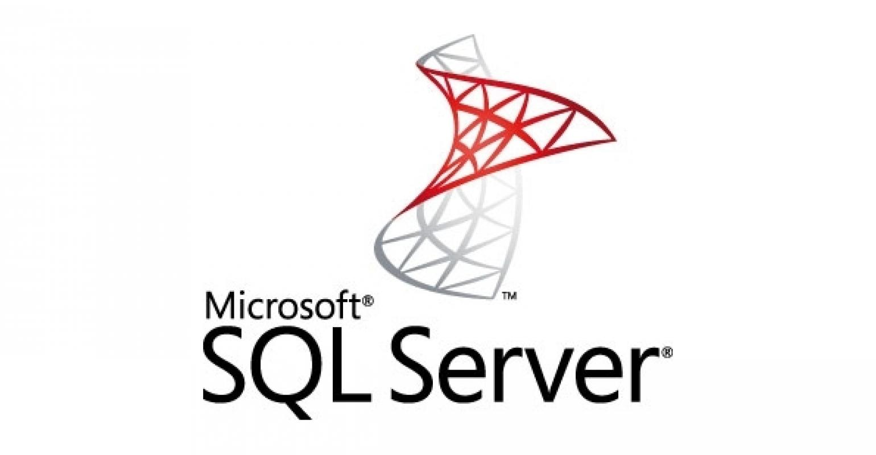
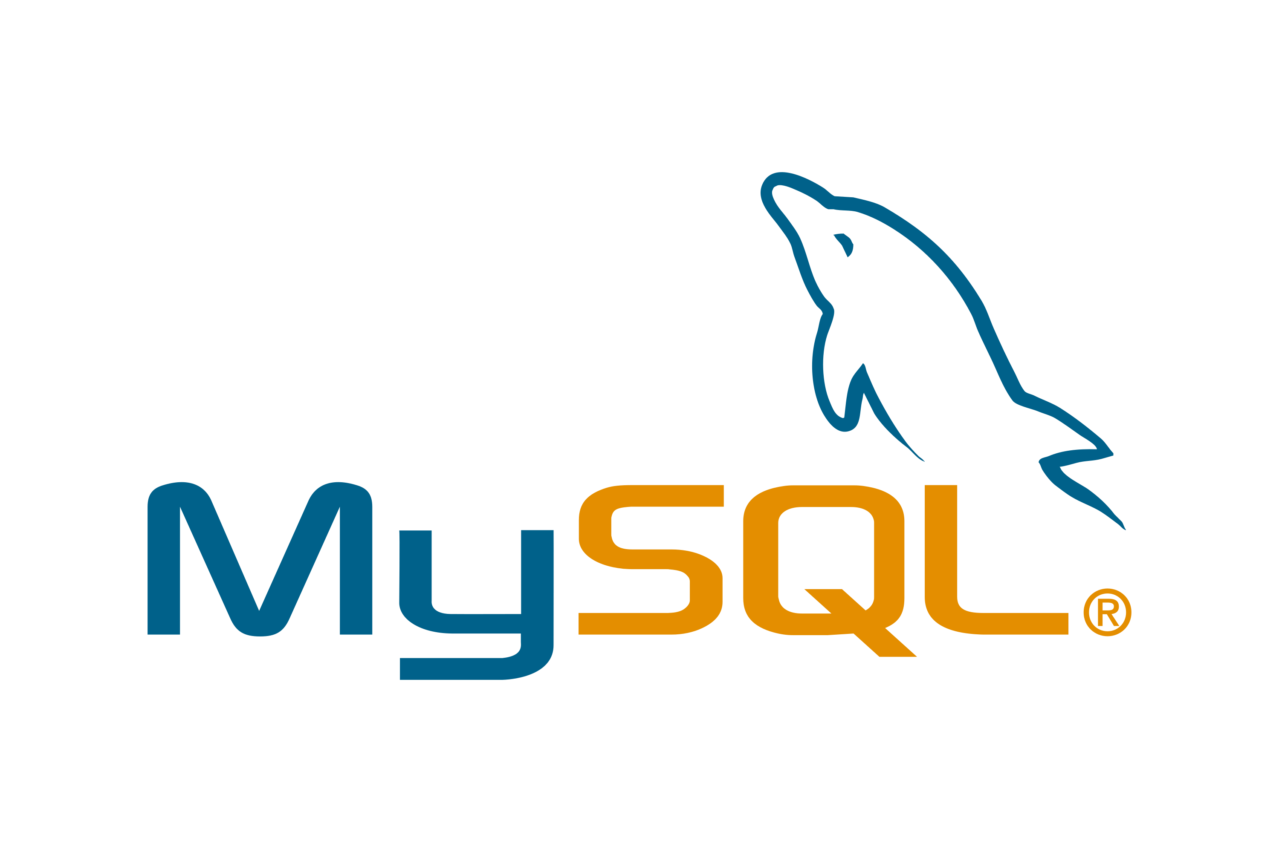
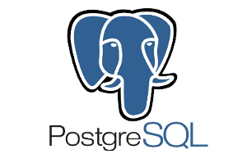
Example of RDBMSs

Slide 4
What is MySQL?
MySQL is an open-source relational database management system (RDBMS,
Its name is a combination of "My", the name of co-founder Michael Widenius's daughter and "SQL",
the abbreviation for Structured Query Language.
Why Choose MySQL?
Simple and straightforward
Open-source
Scalable and fast
Platform-independent
Highly secured

Slide 5
What is PostgreSQL?
PostgreSQL is a powerful, open source object-relational database system
that uses and extends the SQL language combined with many features,
Why Choose PostgreSQL?
Open Source DBMS
Diverse Community
Function.
ACID and Transaction.
Diverse indexing techniques.
Flexible Full-text search.
Diverse kinds of replication.
Diversified extension functions.

Slide 6
What is SQL SERVER?
SQL Server is a relational database management system, or RDBMS,
developed and marketed by Microsoft.
SQL Server 2017 became generally available in October 2016 that ran on both Windows and Linux.
Why Choose SQL SERVER?
Increases data security.
Ease of configuration.
Optimized data storage.
Data recovery support.
Cost.
Restricted compatibility.
Hardware restrictions.

Slide 7
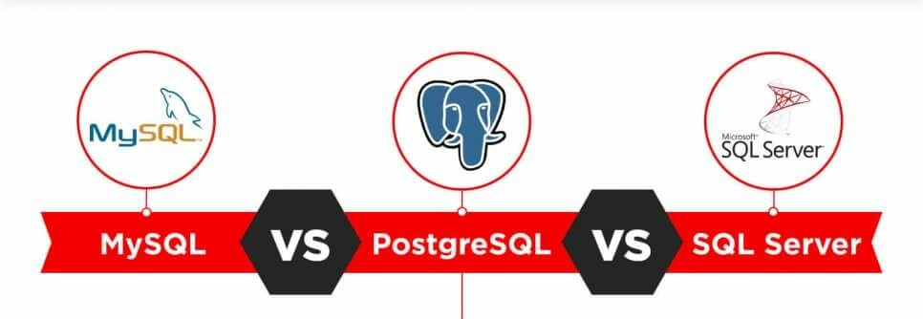
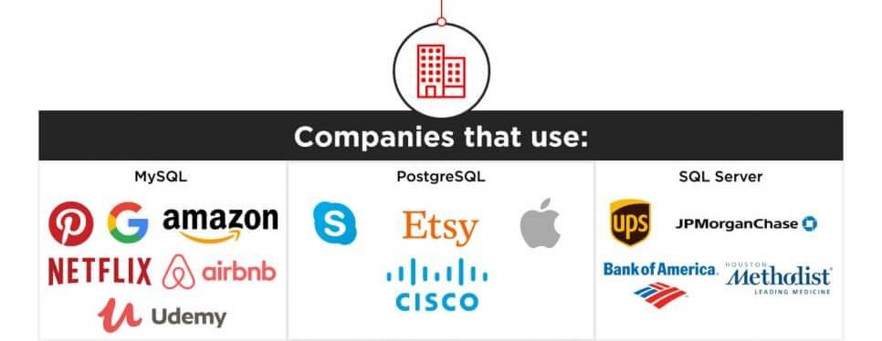

Slide 8
